Slide 1
USING R FOR EPIDEMIOLOGICAL RESEARCH
Kiffer G. Card, PhD
Kirk J. Hepburn, MPP

Slide 2
INTRODUCTION TO R
Community-Based Research Centre for Gay Men’s Health

Slide 3
OUTLINE
R Basics
Exploring and Summarizing Data
Combining Data Sets
Recoding Variables
Descriptive Statistics

Slide 4
1.1. R-BASICS
Types of statistical software
About R
Installing R
Installing RStudio
A quick tour of RStudio
Getting help
R packages
R syntax
Annotating your R code

Slide 5
Types of Statistical Software
Command-line software (e.g., SAS, R, SPSS scripts)
requires knowledge of syntax of commands
reproducible results through scripts
detailed analyses possible
GUI-based software (e.g., SPSS point-and-click functions, Excel)
does not require knowledge of commands
not reproducible actions
Hybrid types (both command-line and GUI)

Slide 6




Types of Statistical Software
SPSS, STATA, and SAS users are like muggles. They are limited in their ability to change their environment. They have to rely on algorithms that have been developed for them. The way they approach a problem is constrained by how SAS/IBM-employed programmers thought to approach them. And they have to pay money to use these constraining algorithms.

Slide 7

Types of Statistical Software
R users are like wizards. They can rely on functions (spells) that have been developed for them by statistical researchers, but they can also create their own. They don’t have to pay for the use of them, and once experienced enough (like Dumbledore), they are almost unlimited in their ability to change their environment.

Slide 8
About R
R is a statistical language that was developed in response to Bell Labs (1976) S/S-plus language.
R is commonly accessed through the integrated development environment called RStudio.
Base R performs a vast number of useful statistical operations.
Base R can be enhanced with packages.
These packages are open source, created by the community of R users, and typically documented in the Journal of Statistical Software. These resources are therefore open for public use free of charge.

Slide 9
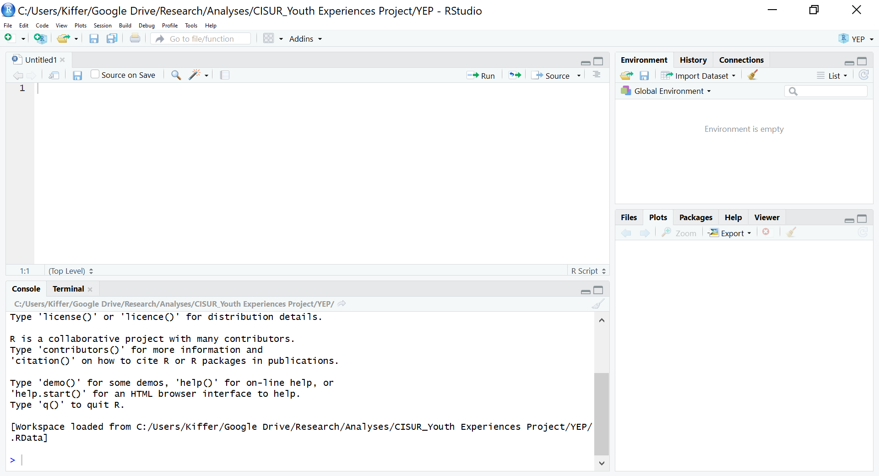
A quick tour of RStudio
Notes:
R studio is divided into four windows.

Slide 10
A quick tour of RStudio
The top left window is a script editor.
Here you can type, edit, and execute R code (by highlighting and hitting “ctrl + Enter”).

Slide 11
A quick tour of RStudio
The bottom left is the R console, where the R engine does its work. Your code is executed here, with results and error notifications. You can also enter ad hoc commands in this window, but these commands will not be saved.

Slide 12
A quick tour of RStudio
Retains Code You Type Here
Does NOT Retain Code You Type Here
Notes:
Good to “check your work” or perhaps “test” a line of code in the console.

Slide 13
A quick tour of RStudio
In the top right, R objects are displayed and summarized. Objects are named sets of data, whether a set of data from a survey, a list of names, a set of randomly generated numbers, or even functions you have defined (created) yourself.
Note: R is case sensitive. DATA, data, and Data would be three different objects.

Slide 14
A quick tour of RStudio
The bottom right contains several useful tools, including…

Slide 15
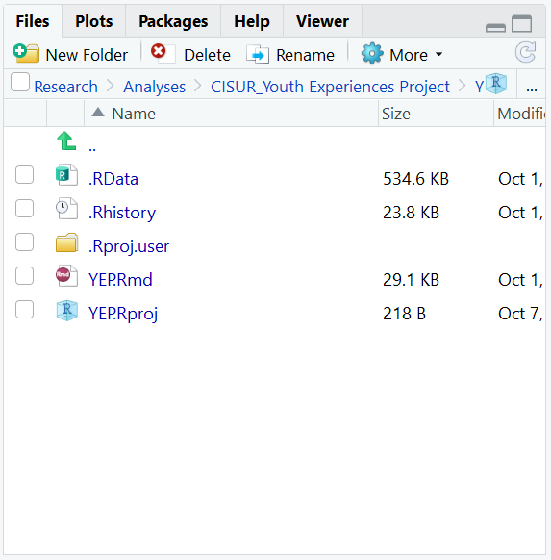
A quick tour of RStudio
The bottom right contains several useful tools, including…
a file explorer,

Slide 16
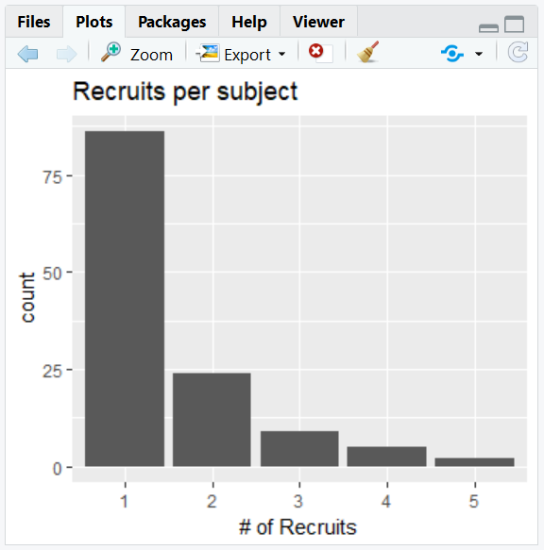
A quick tour of RStudio
The bottom right contains several useful tools, including…
a file explorer,
a graphical device for displaying any plots you create,

Slide 17
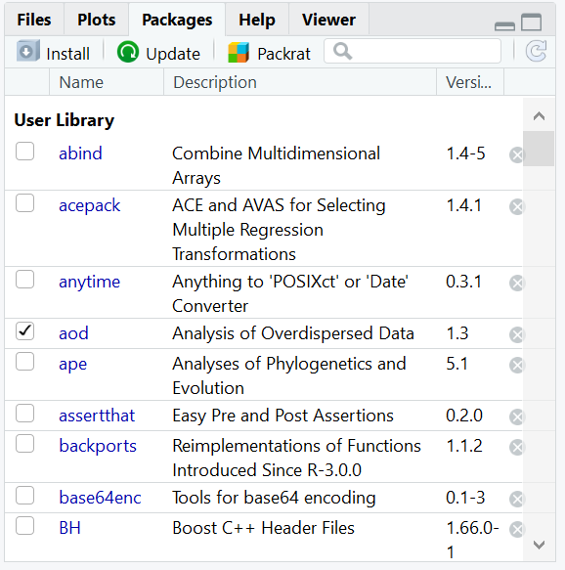
A quick tour of RStudio
The bottom right contains several useful tools, including…
a file explorer,
a graphical device for displaying any plots you create,
a list of the packages you have installed, and

Slide 18
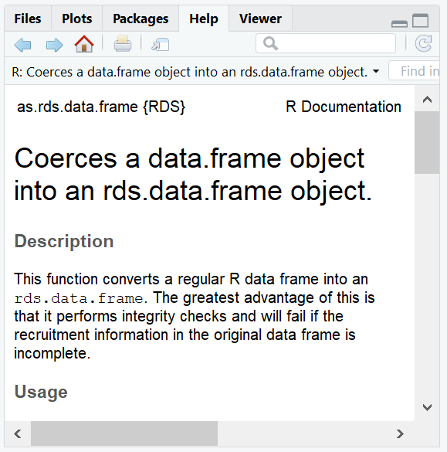
A quick tour of RStudio
The bottom right contains several useful tools, including…
a file explorer,
a graphical device for displaying any plots you create,
a list of the packages you have installed, and
a browser for help documentation.

Slide 19
Getting Help
Specific functions are described fully in R and can be found in the “help” viewer.

Slide 20
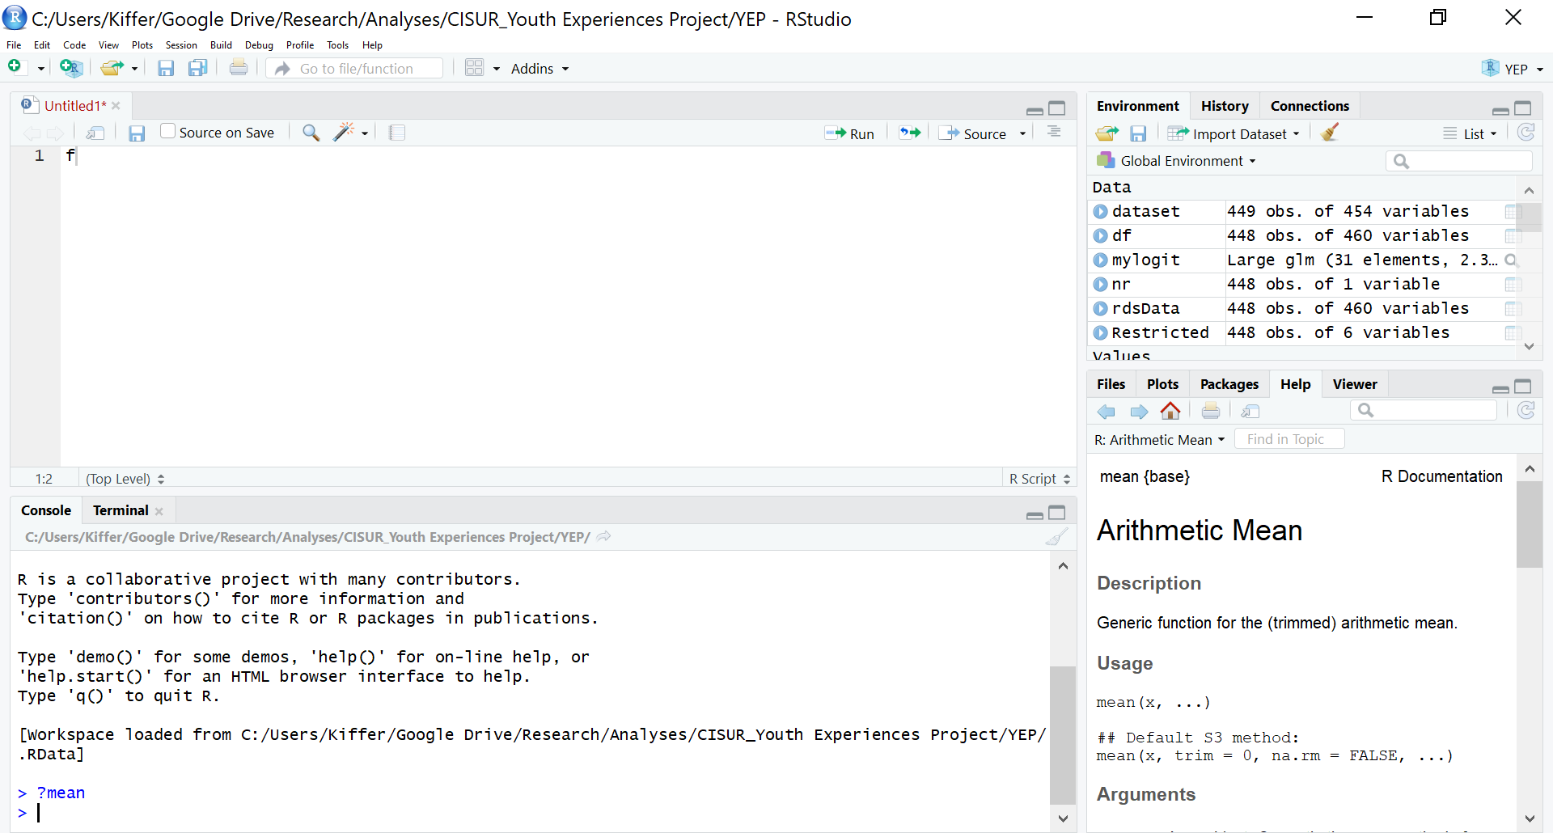
Getting Help
1
?<function name>
2

Slide 21

Getting Help
<function name>
1
2
3

Slide 22
Getting Help
Furthermore, if you have questions about a specific function or error, the R community is extremely active.
Your question has likely already been asked on StackExchange or similar websites:
https://stackexchange.com/
https://www.r-bloggers.com/
https://www.statmethods.net/

Slide 23

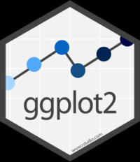


R Packages
Notes:
As mentioned, R packages are sets of additional functions which make R more pleasant or useful. For instance, dplyr provides some quick functions for manipulating and summarizing data which would require much more code in base R. ggplot2 expands on base R’s graphing functions to offer a wide array of additional and more complex graphing capabilities, including maps! forcats and stringr provide functions which make it easier to work with factor and string data, respectively, which we will discuss later.

Slide 24
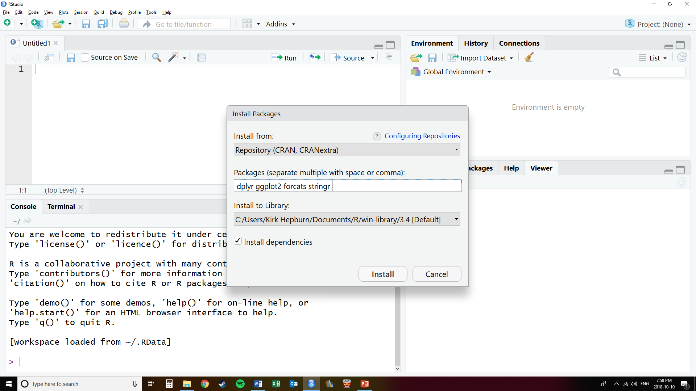
R Packages
Notes:
Installing R in RStudio is made easy by using the Tools>Install Packages dialogue box. Simply type in the names of the packages you want and click Install. R will retrieve the packages from the CRAN repository for you.

Slide 25
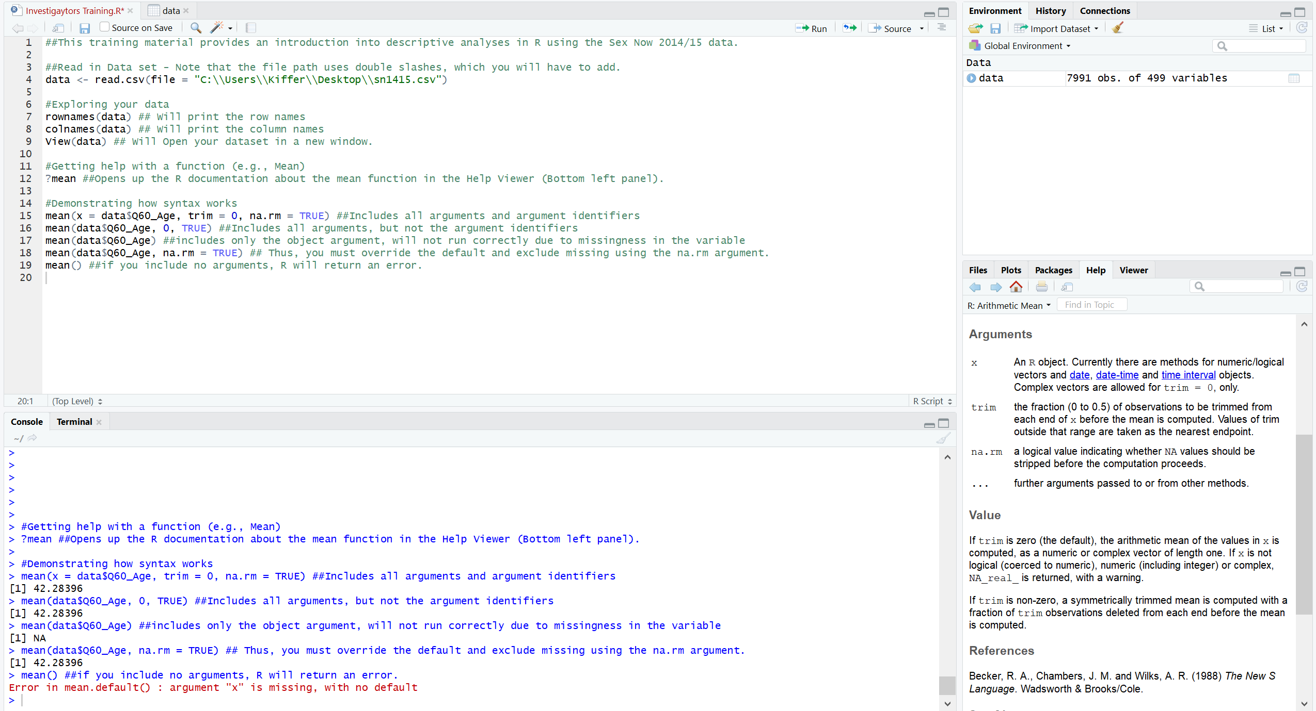
R Syntax
Notes:
An R function almost universally follows this form: [function name]([arguments]). For instance, the `mean` function can take the following arguments, each of which is described in the functions help file:
You can specify all or only some of the arguments. In the first example, the mean age is calculated. Every argument is listed and named: the R object to use is data$var, the trim fraction is 0, and missing values are not stripped. This is tidy, but not terribly necessary, since defaults are set for most of the arguments. The arguments don’t need to be named, so R will evaluate them in the order the help file shows. They don’t all even have to be included in a function call; if an argument is missing, R will assume you want the default. Notice how leaving out an argument that doesn’t have a default caused an error.
This slide also introduces the script editor in action.

Slide 26
Annotating Your R Code
Notes:
COMMENT YOUR CODE YOU WILL REGRET NOT DOING SO AND PEOPLE WILL HATE YOU IF THEY NEED TO READ IT LATER

Slide 27
1.2. EXPLORING DATA
Entering your data
Using R to look at your data
Types of data in R
Data dictionaries
Skip Patterns

Slide 28
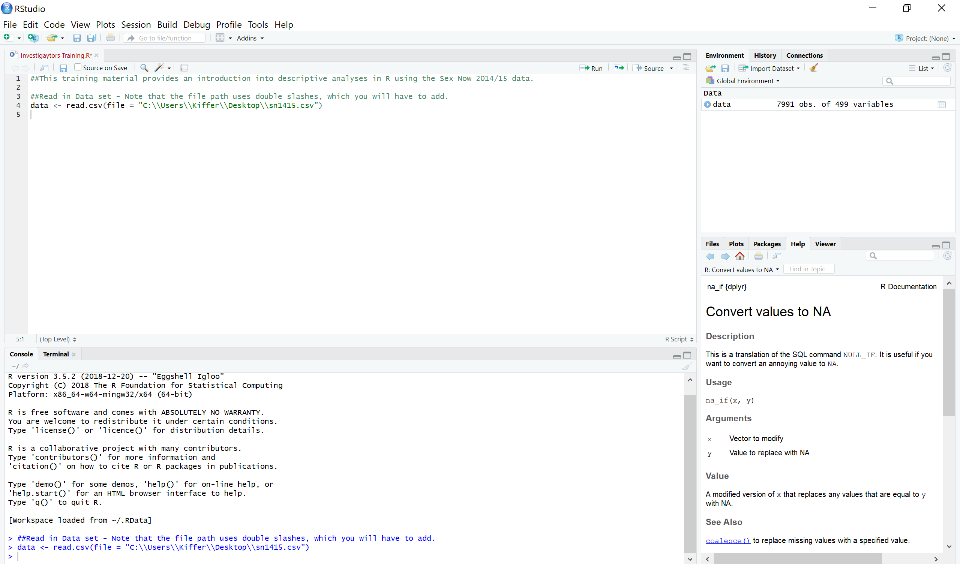
Reading in Your Data
Notes:
Before we begin using R to explore data, we must read that data into the R environment. Anything stored in the R environment’s memory is called an object. To assign data to an object, we use the <- syntax.
Much of the data that you encounter in your careers will be stored in comma-separated values or other text-based formats (.tab, for instance), and R has commands specifically for these formats: read.csv, read.delim, etc. Lots of data are stored as Excel, SPSS, SAS, and other formats. For these formats, packages exist which provide the functions needed to read these data.
To view a larger dataset, it is easiest to use RStudio’s View function, which you can type in or simply click on the object in the environment frame. For smaller datasets, you can just call the dataset like a function and the R console will print the data for you.

Slide 29
R Data Types
R has a wide variety of classes of objects.
The classes that you should be concerned with:
Vectors
Numeric - 1, 2, 5.3, 6, -2 , 4, NA
Factor - 1, 2, 3, 2, 3, 3, 2, 1, NA
Character/String - "one", "two", "three“, NA
Logical - TRUE, TRUE, FALSE, NA
Data frames – objects that can contain multiple objects (as columns) with different classes
You can check an object’s class using the “class()” function.

Slide 30
Data Dictionaries
A data dictionary, or metadata repository, as defined in the IBM Dictionary of Computing, is a "centralized repository of information about data such as meaning, relationships to other data, origin, usage, and format.”
Provides question & response text
Provides variable name & response codes
Provides descriptive frequency counts & proportions
Provides information about skip/display logic
Provides codes for missing-ness
Provides information about the data type for each variable

Slide 31
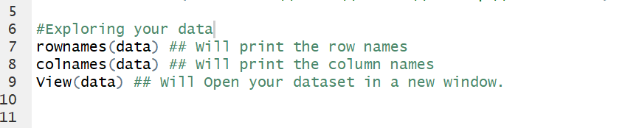
Using R to Look at Your Data
Notes:
Most data we are interested in will have two dimensions. You will be familiar with spreadsheets, with rows and columns.
Rows and columns in R have names. Using a set of data on guinea pit tooth growth in response to vitamin C, we can see the names for the rows. They’re just numbers, which is straightforward (maybe a little sad, since those are each guinea pigs). The columns, though, are named len, supp, and dose, which each mean tooth length, supplement given, and dose.
If we want to select only part of a dataset, we use the square brackets, specifying the row and column in that order. Here I get the supplement given to guinea pig 51. He or she was given orange juice.

Slide 32
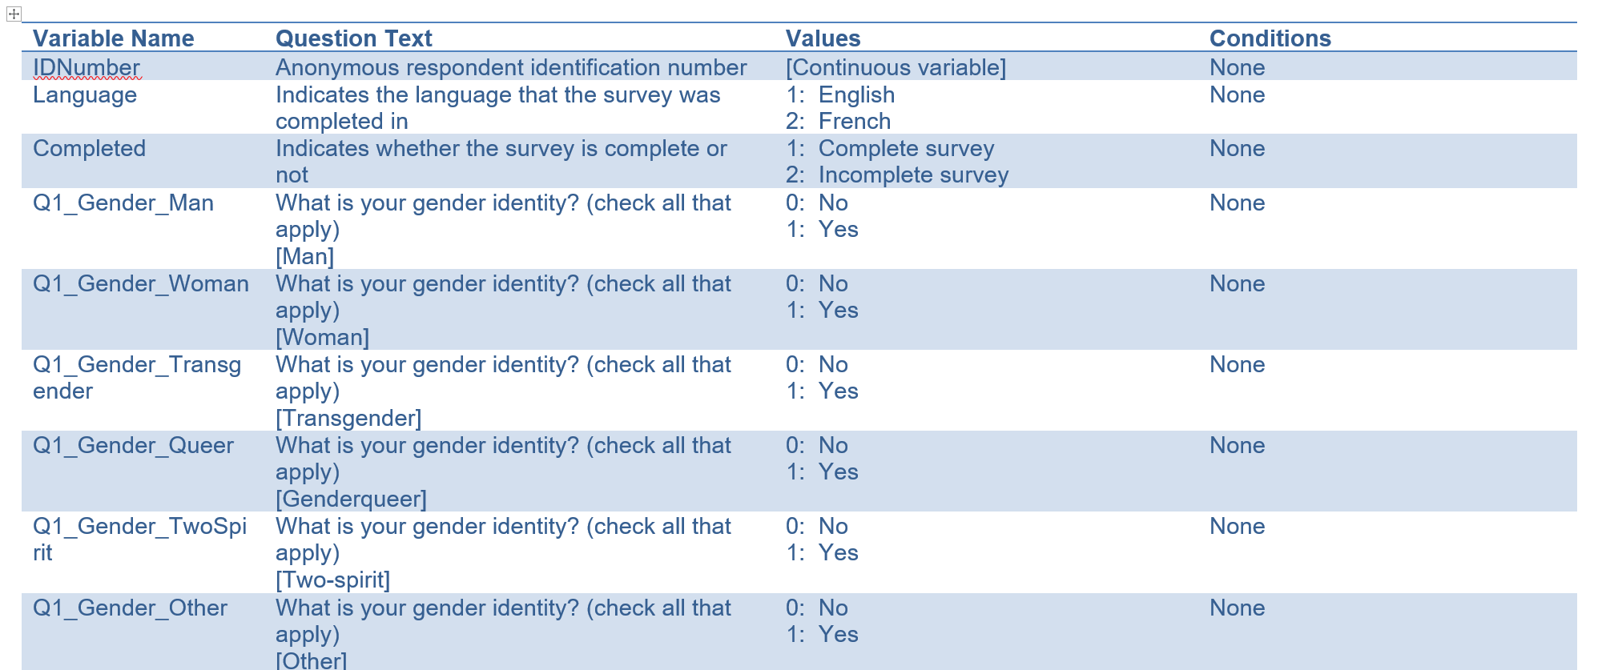
Sex Now Data Dictionary
Variable Name
Variable Text
Response Options and Values
Skip Logic

Slide 33
1.3. SUMMARIZING DATA
Frequencies
Proportions
Cross-Tabulated Frequencies
Cross-Tabulated Proportions
Measures of Central Location
Measures of Spread
Hypothesis Tests
Correlation Tests

Slide 34
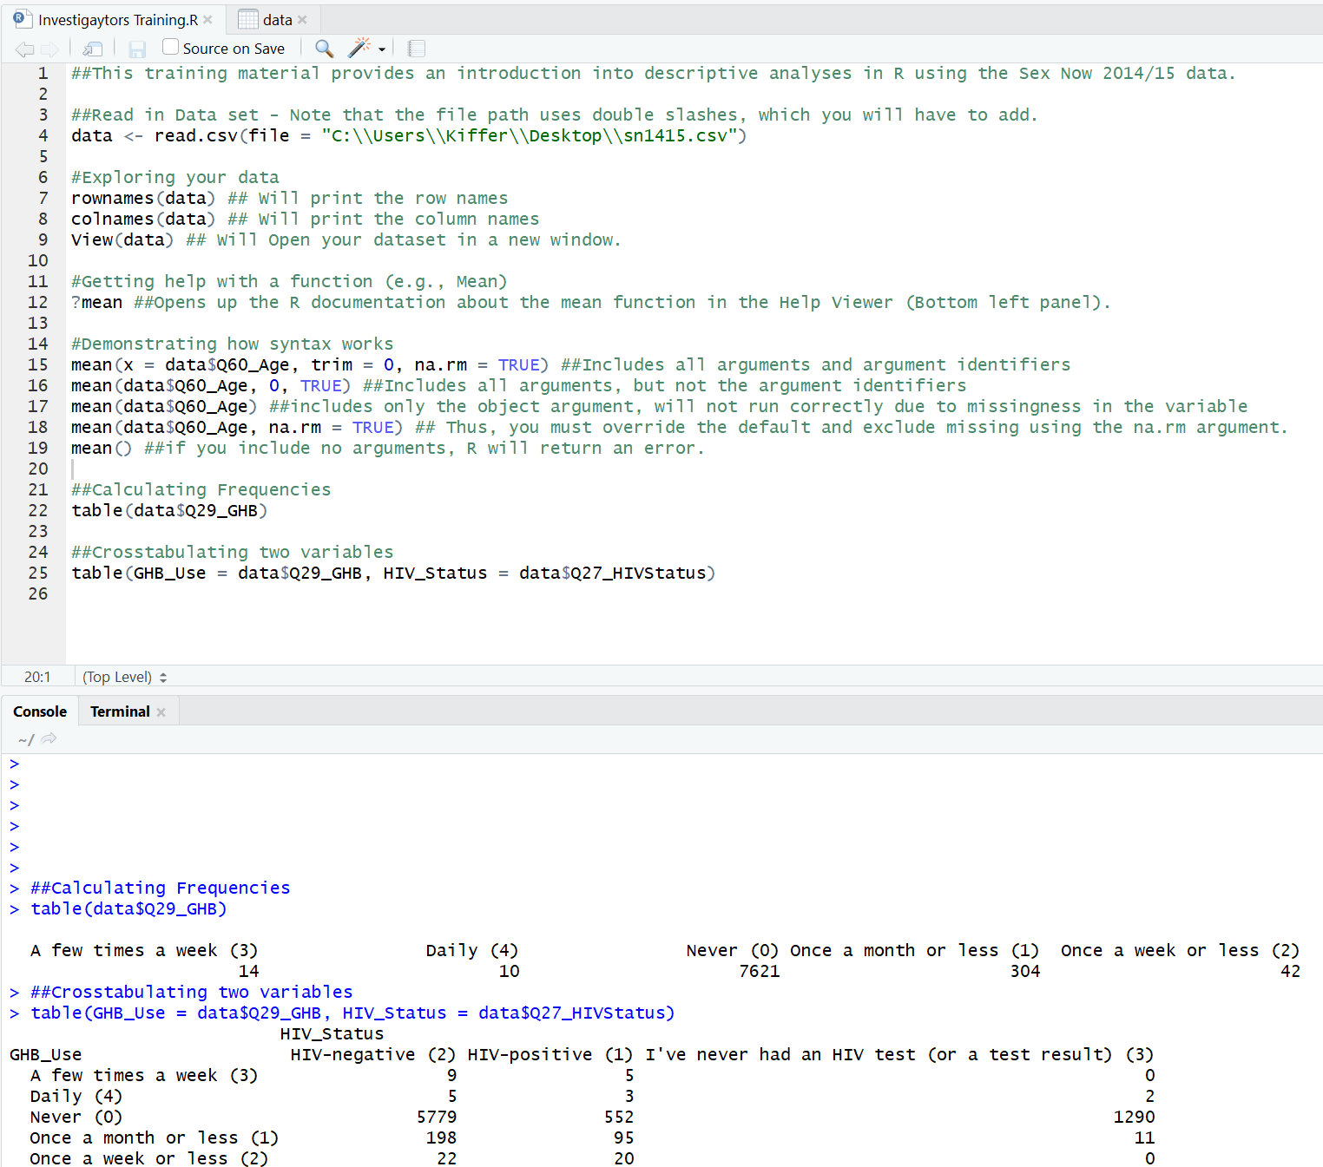
Frequencies
Count of the occurrences of a value
“Cross-tabulate”: to count the occurrences of a value across different sets of data
Notes:
Data from a Greek matched case-control study from the 1970s of secondary infertility after induced abortion. First table is of education level, while the second education level by the number of previous births after 20 weeks.

Slide 35
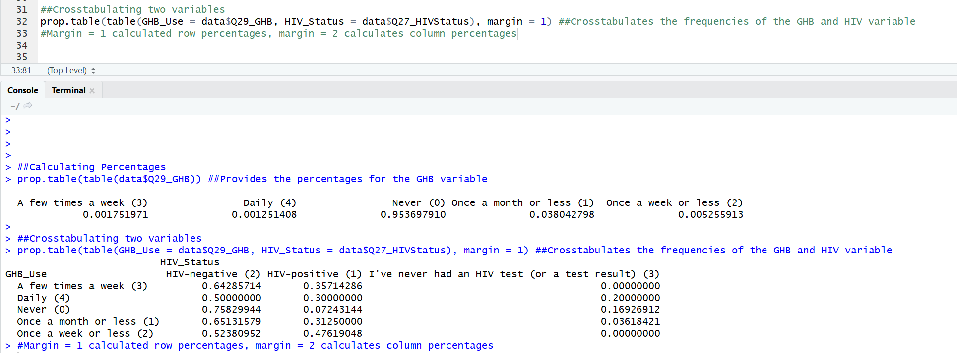
Proportions
Proportion of total occurrences matching each value
Notes:
These are proportions based on the same data

Slide 36
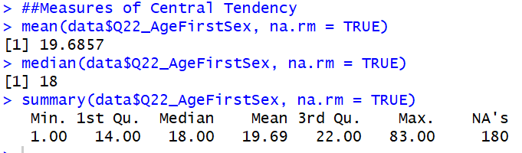
Measures of Central Location

Slide 37

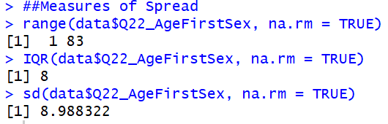
Measures of Spread
Range
Standard Deviation
Interquartile Range

Slide 38
Hypothesis Tests
T-tests
Welch’s t-test
Mann-Whitney
Chi-square
Pearson’s correlation
Spearman’s Rank
Kendall Rank

Slide 39
Independent t-test
The unpaired two-samples t-test is used to compare the mean of two independent groups.
alternative = “greater”, “less”, or “two.sided”
var.equal = if FALSE calculates Welch’s t-test; if TRUE calculates the Student’s t-test
t.test(var ~ grp, alternative = “two.sided”, var.equal = TRUE, data = dat)

Slide 40
Assumptions of Independent t-test
Independence of Observations
Normal distribution
Test using a Shapiro-Wick Normality Test
Equal Variances (Only Student’s t-test)
If the variance of the two groups are heteroscedastic, you calculate a Welch t-test instead.
shapiro.test(dat$var[dat$group == ‘group 1’])
shapiro.test(dat$var[dat$group == ‘group 2’])
res.ftest <- var.test(var ~ grp, data = dat)
res.ftest
Notes:
Welch’s test still assumes formality, if the variables are not normal than mann-Whitney (next slide) is used.

Slide 41
Mann-Whitney Test
(a.k.a. Mann-Whitney-Wilcoxon test, Wilcoxon Rank-Sum)
The unpaired two-samples Wilcoxon test (also known as Wilcoxon rank sum test or Mann-Whitney test) is a non-parametric alternative to the unpaired two-samples t-test, which can be used to compare two independent groups of samples. It’s used when your data are not normally distributed.
res <- wilcox.test(var ~ grp, data = dat)
res

Slide 42
Chi-Squared Test
The chi-square test of independence is used to analyze the frequency table (i.e. contengency table) formed by two categorical variables.
Usually used for non-dichotomous variables.
chisq.test(x = dat$var1,y = dat$var2, data = dat)

Slide 43
Pearson's Correlation
Correlation test is used to evaluate the association between two or more variables.
res <- cor.test(dat$var1, dat$var2, method = “pearson”)
res

Slide 44
Assumptions of Pearson's Correlation
Linear association
Plot scatter plot with regression line.
Normal distribution
Check that both variables are normally distributed using the shapiro.test() function

Slide 45
Spearmen’s Rank Test
Spearman’s rho statistic is the most widely used rank-based measure of association.
res <- cor.test(dat$var1, dat$var2, method = “spearman”)
res

Slide 46
Kendall Rank Test
The Kendall rank correlation coefficient or Kendall’s tau statistic is used to estimate a rank-based measure of association. Kendall’s rank has better statistical properties, though is less widely used.
res <- cor.test(dat$var1, dat$var2, method = “kendall”)
res

Slide 47
1.4. CHANGING DATASETS
Dropping Variables
Dropping Observations

Slide 48
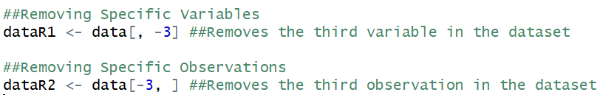
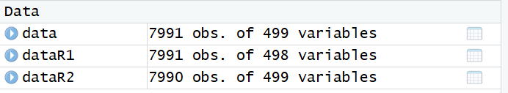
Dropping Variables or Observations
If you’re interested in removing just one variable.

Slide 49
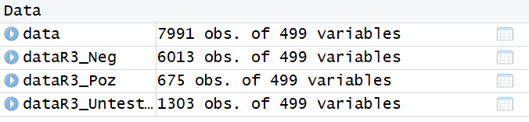
Subsetting Observations

Slide 50
1.5. RECODING VARIABLES
Recoding Categorical Variables
Categorizing Continuous Data
Combining Variables
Missing Data

Slide 51
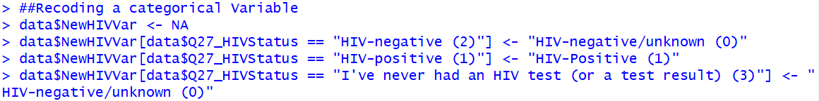
Recoding Categorical Variables
In the code below we collapse a three-level categorical variable measuring HIV Status into a dichotomous variable:
Don’t forget to check your work by creating tables for each (or a cross tabulation for more complex factors.

Slide 52
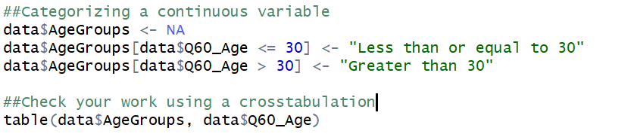
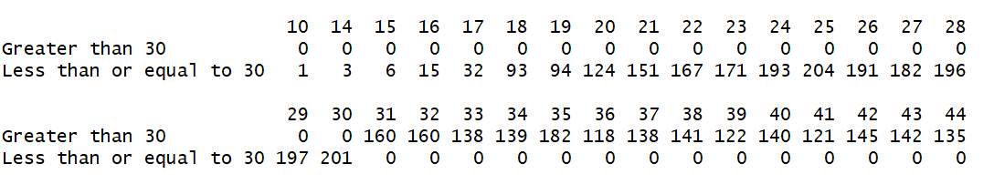
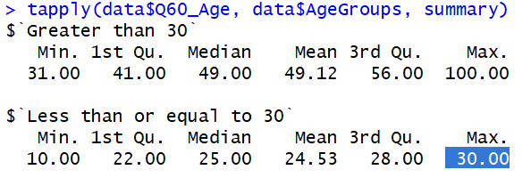
Categorizing Continuous Data

Slide 53
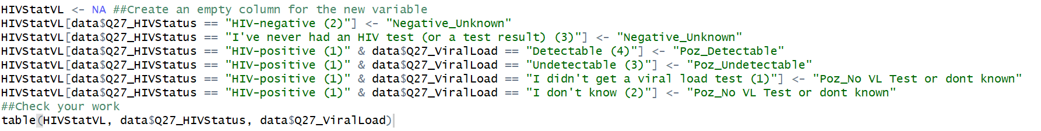
Combining Variables
In the code below we collapse the two variables we just created into a single variable:
This is done by using the “&” in the where statement when defining a new variable.
Notes:
(This is often useful when skip logic is employed)

Slide 54
1.6. DATA VISUALIZATIONS
Bar Charts
Histograms

Slide 55
Data Visualizations
Most plots can be generated using either
Base R
or
ggplot
Because the R community is quite active, you can usually figure out how to do plots by googling “How to make a _______ in r.”
For example, I found the following two guides – both of which are quite useful:
Base R - https://www.statmethods.net/graphs/index.html
Ggplot - http://www.sthda.com/english/wiki/ggplot2-barplots-quick-start-guide-r-software-and-data-visualization

Slide 56
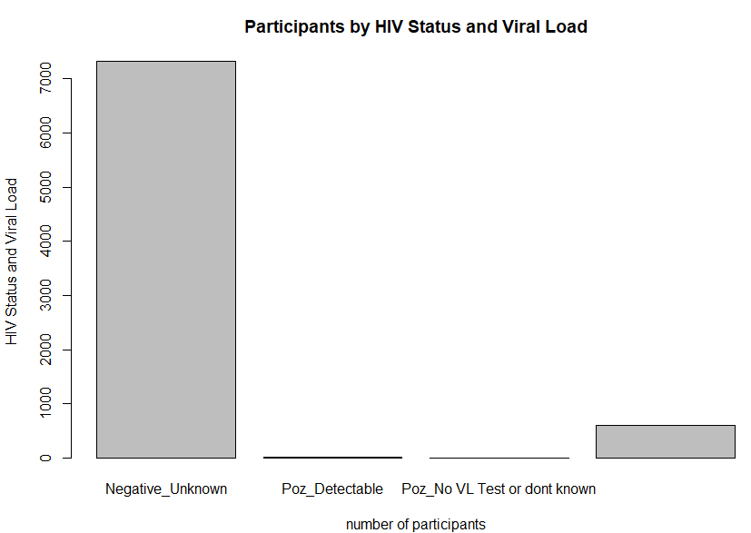
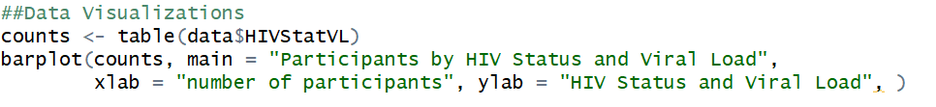
Bar Charts
A bar chart or bar graph is a chart or graph that presents categorical data with rectangular bars with heights or lengths proportional to the values that they represent. The bars can be plotted vertically or horizontally.

Slide 57
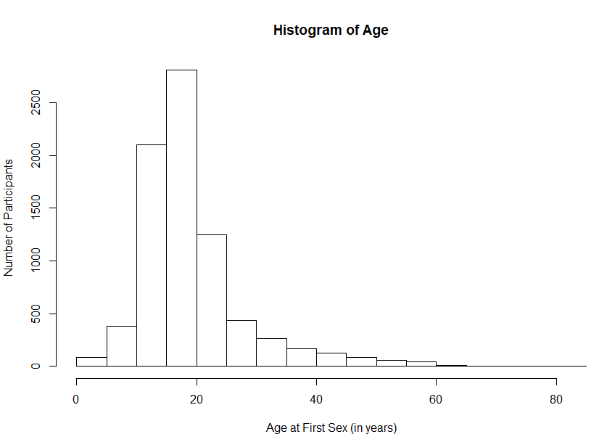
Histograms
A histogram is a plot that lets you discover, and show, the underlying frequency distribution (shape) of a set of continuous data.

